Slide 1


Coupa Supplier Portal:
Quick Reference Guide
May 1, 2023
Insert Client Logo

Slide 2
Agenda
Intro to Coupa Supplier Portal
CSP Reference Guides
Insert Client Logo
  Ways to Join
  Invitation
  Create Account
  CSP Navigation
  Manage Account
  Purchase Orders
  Invoices
  Payments

Slide 3
Introduction to Coupa Supplier Portal (CSP)
The Coupa Supplier Portal (CSP) is a free instance of Coupa made available to suppliers and designed to streamline the procurement process
Signing up to the CSP is critical as it allows suppliers to more efficiently monitor purchase orders and process customer invoices
  We will provide directions on how to register for the CSP within in this presentation and follow up participatory demonstrations
Suppliers will have the ability to access their CSP content and manage settings for their various customer accounts

Slide 4
CSP Registration
Ways to Join
CSP Invitation
Creating Your Account

Slide 5
Ways to Join
Self-Service Invitation
With Release 30, suppliers already registered can initiate the connection process themselves by sending connection requests to their Coupa customers from the CSP
Suppliers with the Admin role can send connection requests by going to Setup > Connection Request
On the Request a Customer Connection screen, the CSP suggests Coupa customers for the supplier to connect with
For more information about supplier connection requests, see View and Manage Connection Requests
Customer-Created Invitation
More commonly, the Coupa customer (Dream) will send you an invitation to join the CSP and take advantage of the portal’s benefits
We will look at this invitation process in the following slides

Slide 6
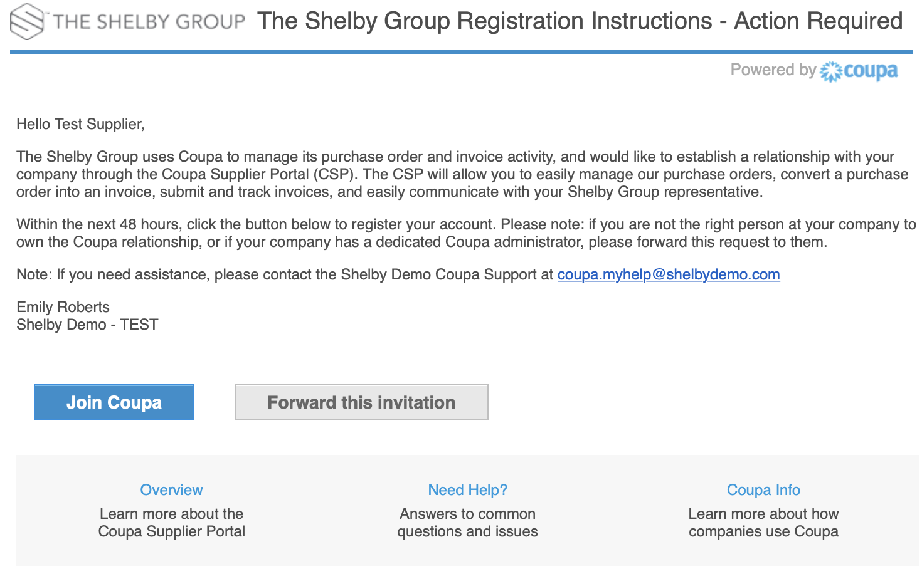
CSP Invitation
You will receive an e-mail from Dream’ Coupa system with a unique link to join the Coupa Supplier Portal
The invitation can be forwarded to additional contacts if appropriate
If you are the correct contact, please proceed with the Join Coupa button
Save https://supplier.coupahost.com as a favorites link for quick access when you need to return to the site

Slide 7
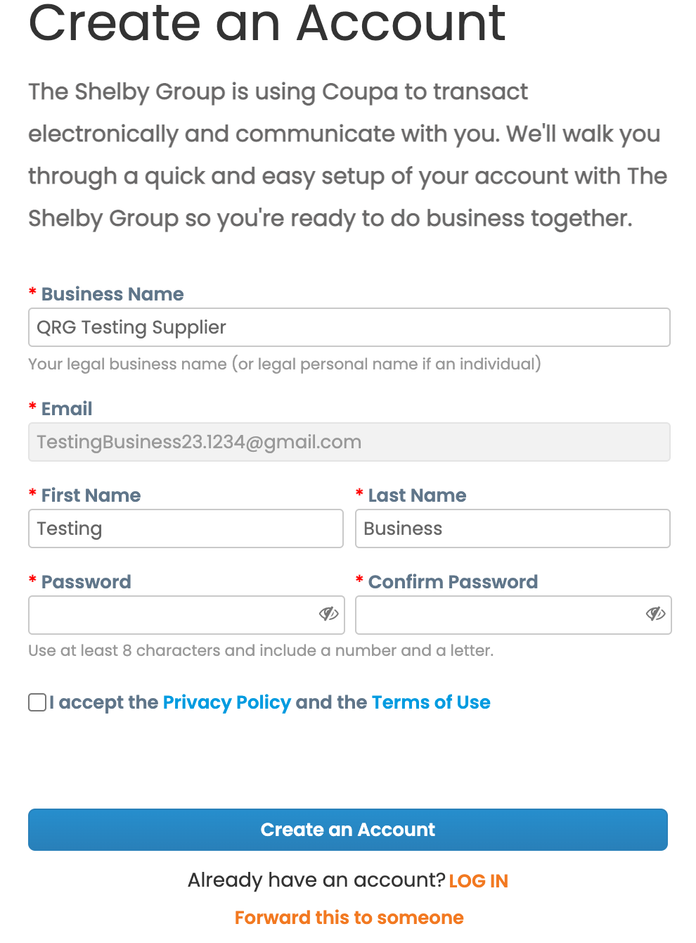
Creating Your Account
Immediately after clicking the Join Coupa button, you will be redirected to the CSP and provided instructions on how to register
Some of your information will be defaulted from the Supplier Record and Contact Information on file with Dream
Once choosing a secure password, click the Create an Account button to finalize your profile

Slide 8
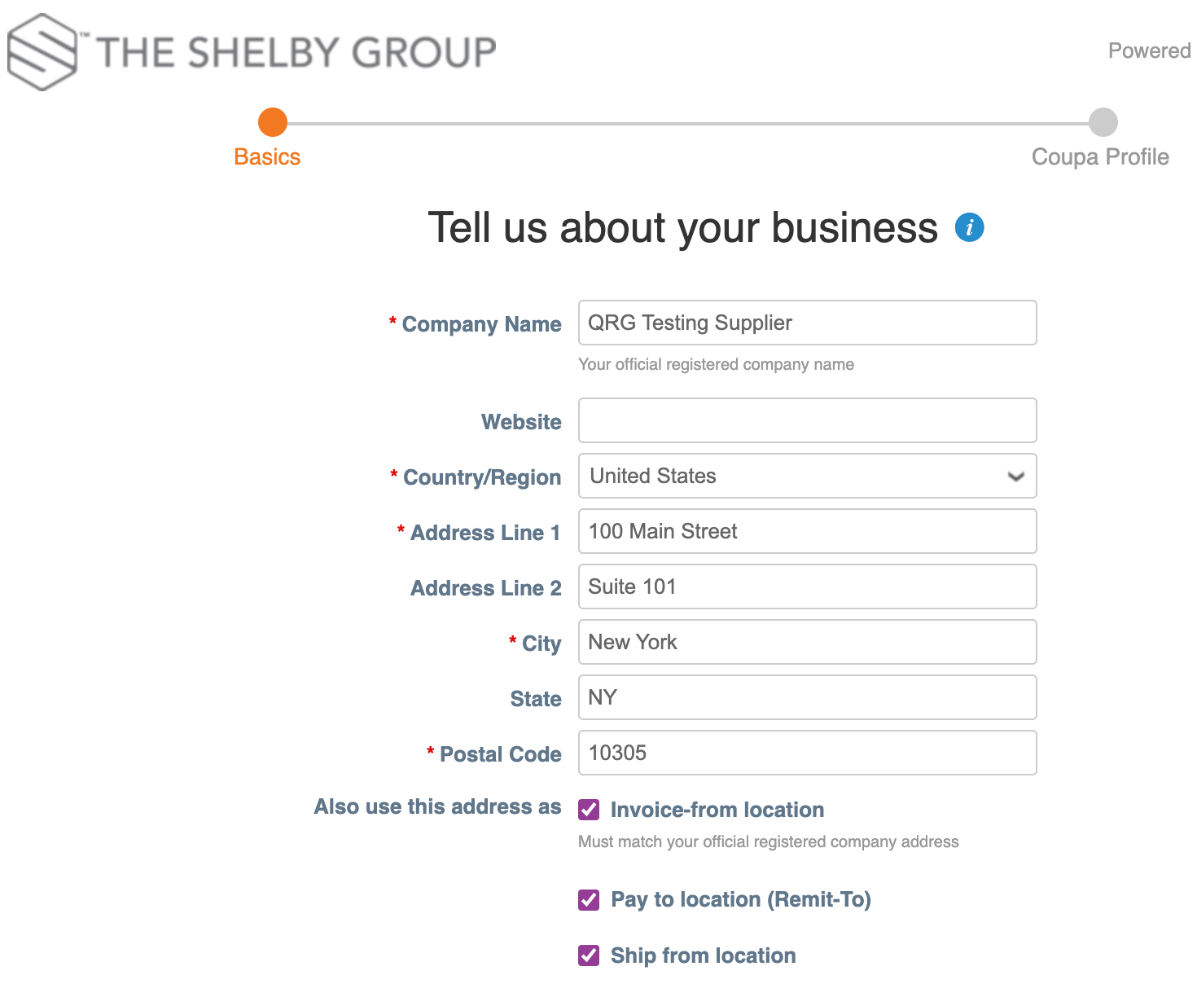
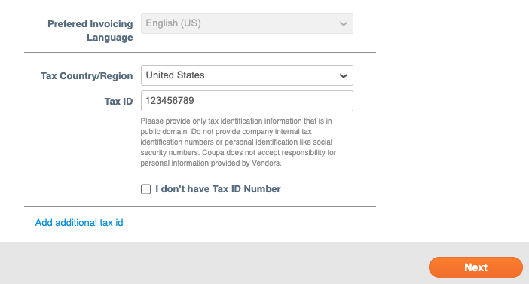
Creating Your Account
From here, you will enter information about your business to complete your CSP profile
  Basic Business Information
  Address / Remittance Information
  Tax Information

Slide 9
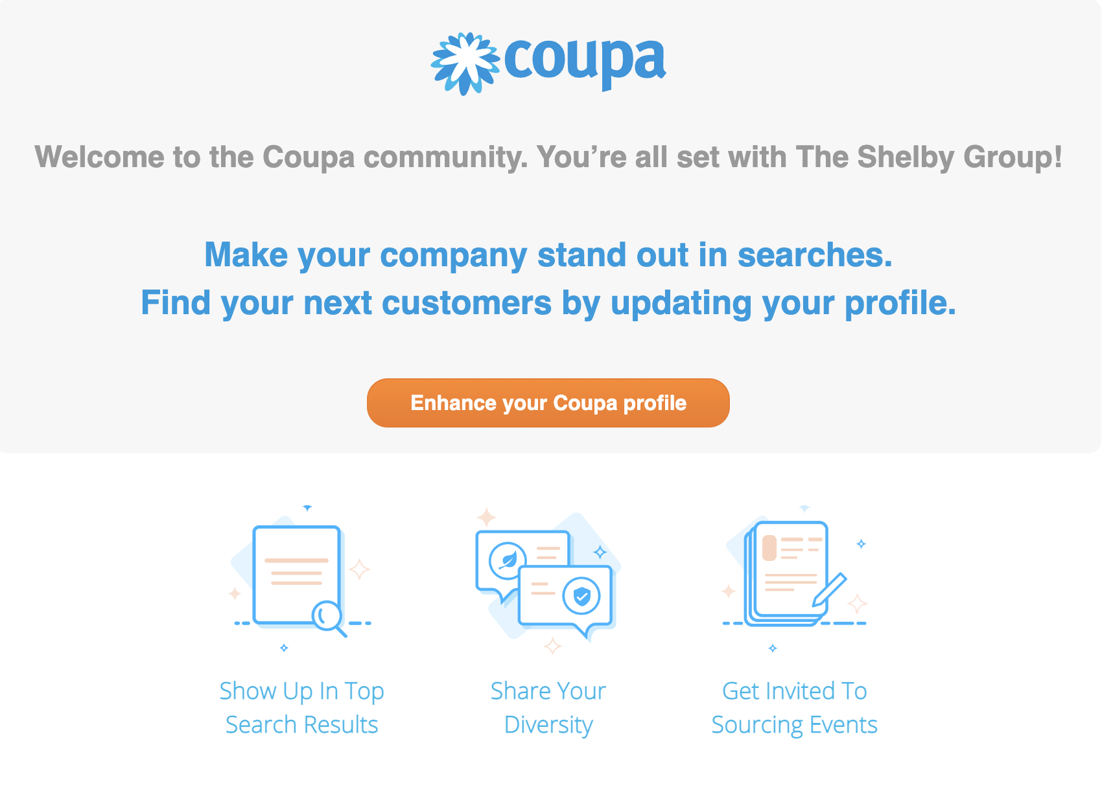

Creating Your Account – Enhance Profile
After clicking Next and finalizing your account, Coupa will invite you to enhance your CSP profile by adding:
  Search Criteria
  Diversity Status - This is a Dream requirement to be completed when joining the CSP
  Sourcing Event eligibility
These profile enhancement steps can always be taken at a later time

Slide 10
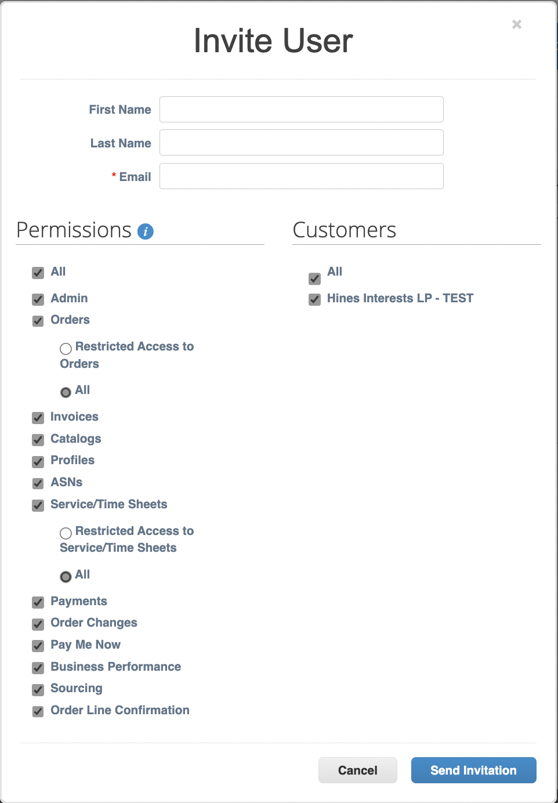
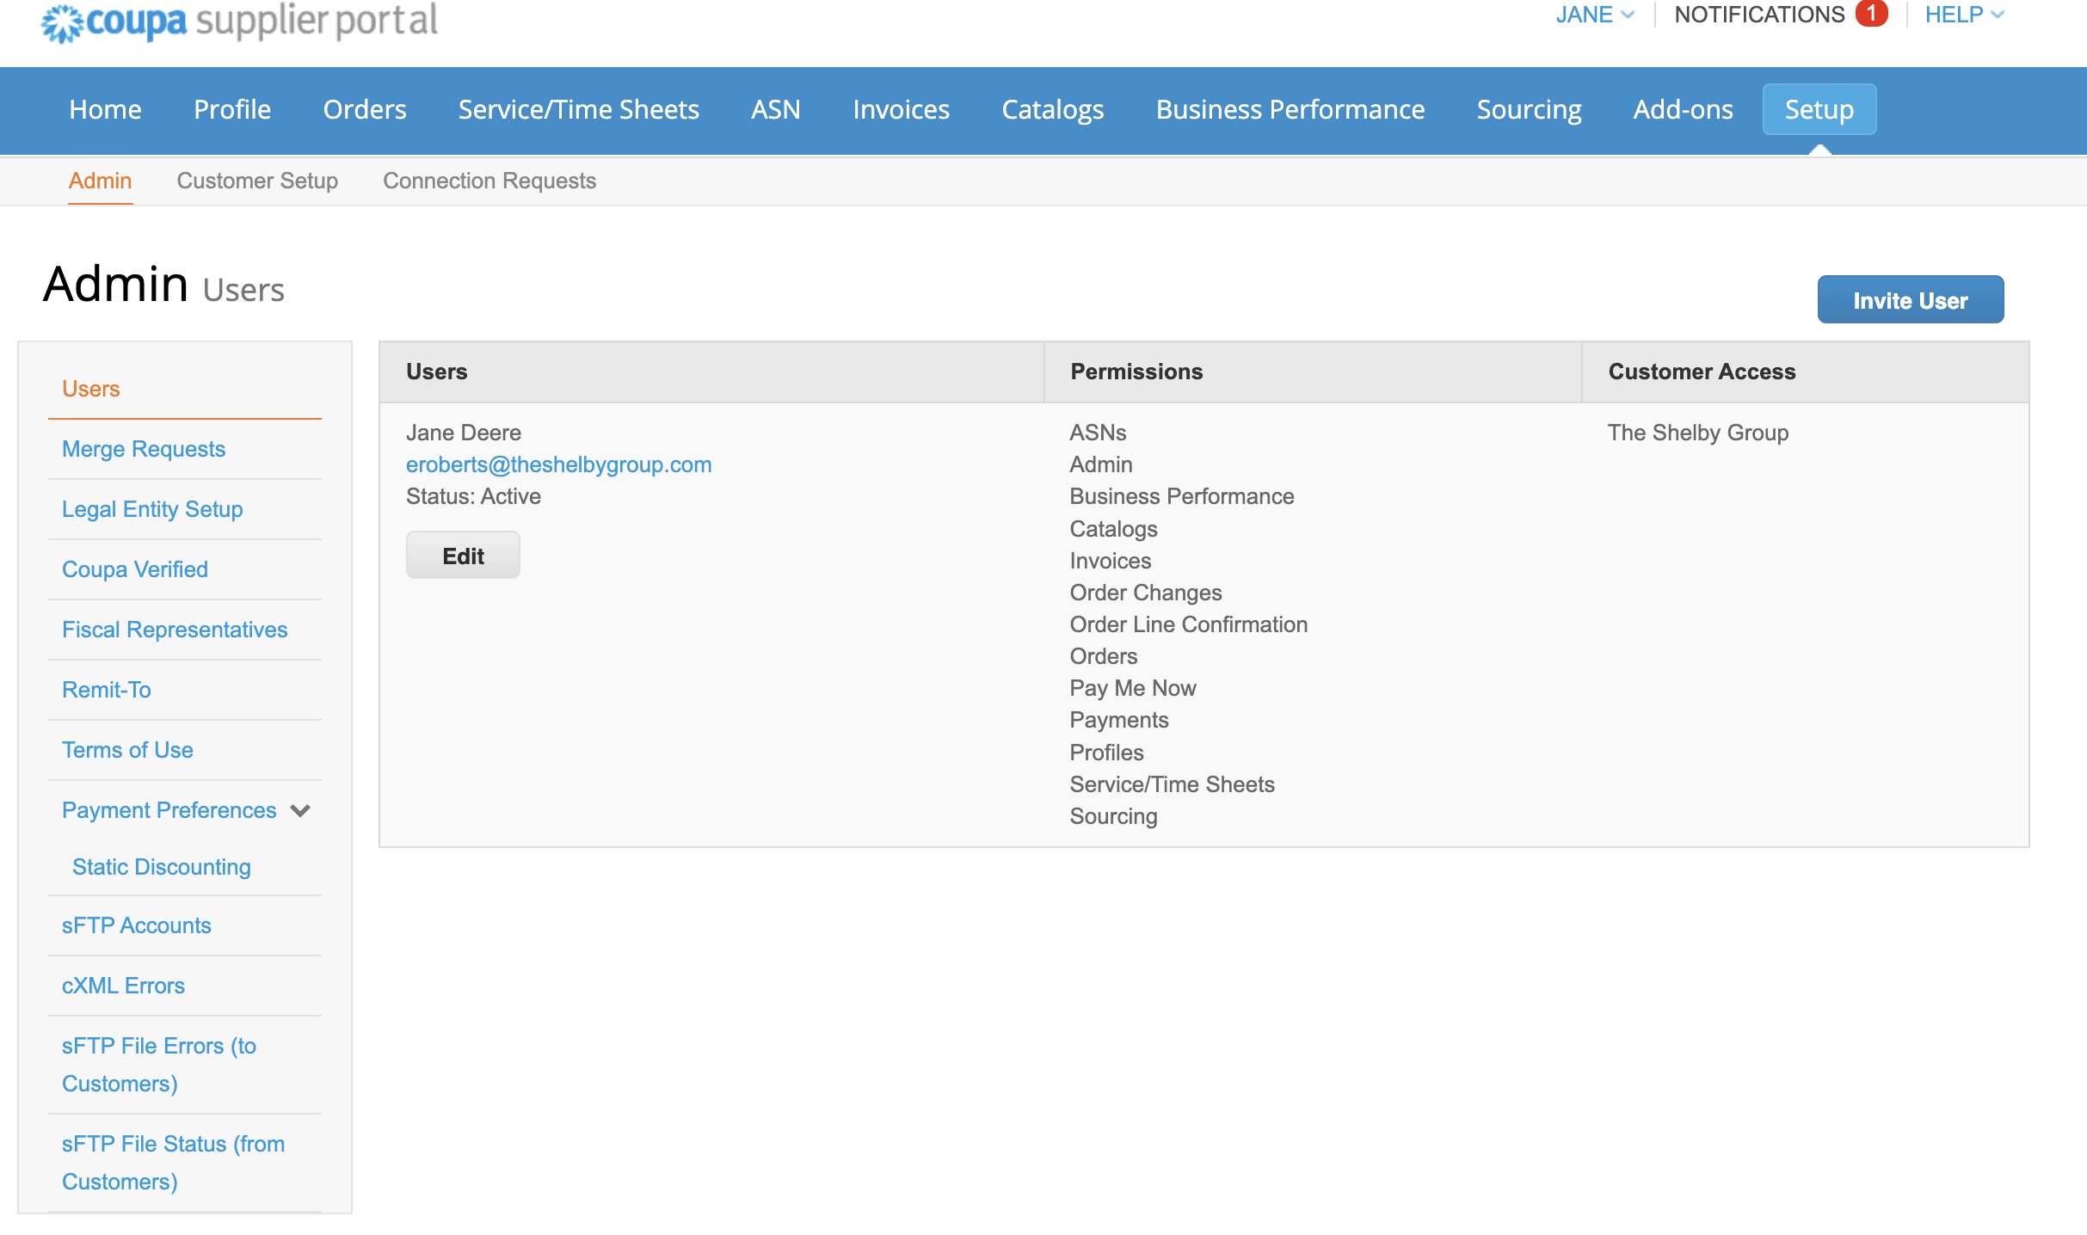
Registration – Inviting Users
Suppliers can add additional users to their CSP account by:
  Navigating to the Setup tab
  Choosing “Invite User”
  Filling out the user contact information
  Selecting the appropriate permissions and customer access
  Hitting “Send Invitation”
The Shelby Group - TEST

Slide 11
CSP Navigation
Home Page Navigation

Slide 12
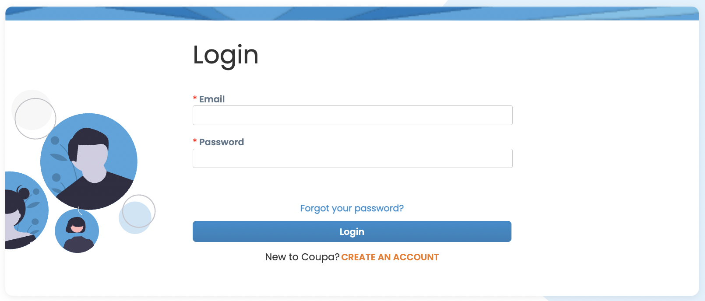
Coupa Supplier Portal Access
Login
  Enter URL
    supplier.coupahost.com
  Log into the CSP using your email and user created password
Supported Browsers:
  Google Chrome (recommended)
  Mozilla Firefox
  Microsoft Edge

Slide 13


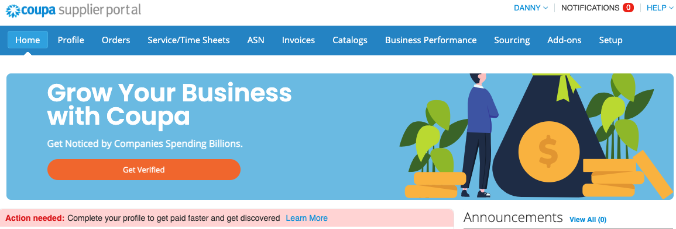



Home Page Navigation
Home Page Icon – Takes user back to Home Page
Navigation Bar – Horizontal tool bar at the top of screen with links to each CSP tab
Account Administration – Access to user account settings
Notifications – Link to notification alerts
Get Verified – Link to Coupa’s supplier verification service for greater visibility

Slide 14
Account Management
Account Administration
Admin
Get Help

Slide 15
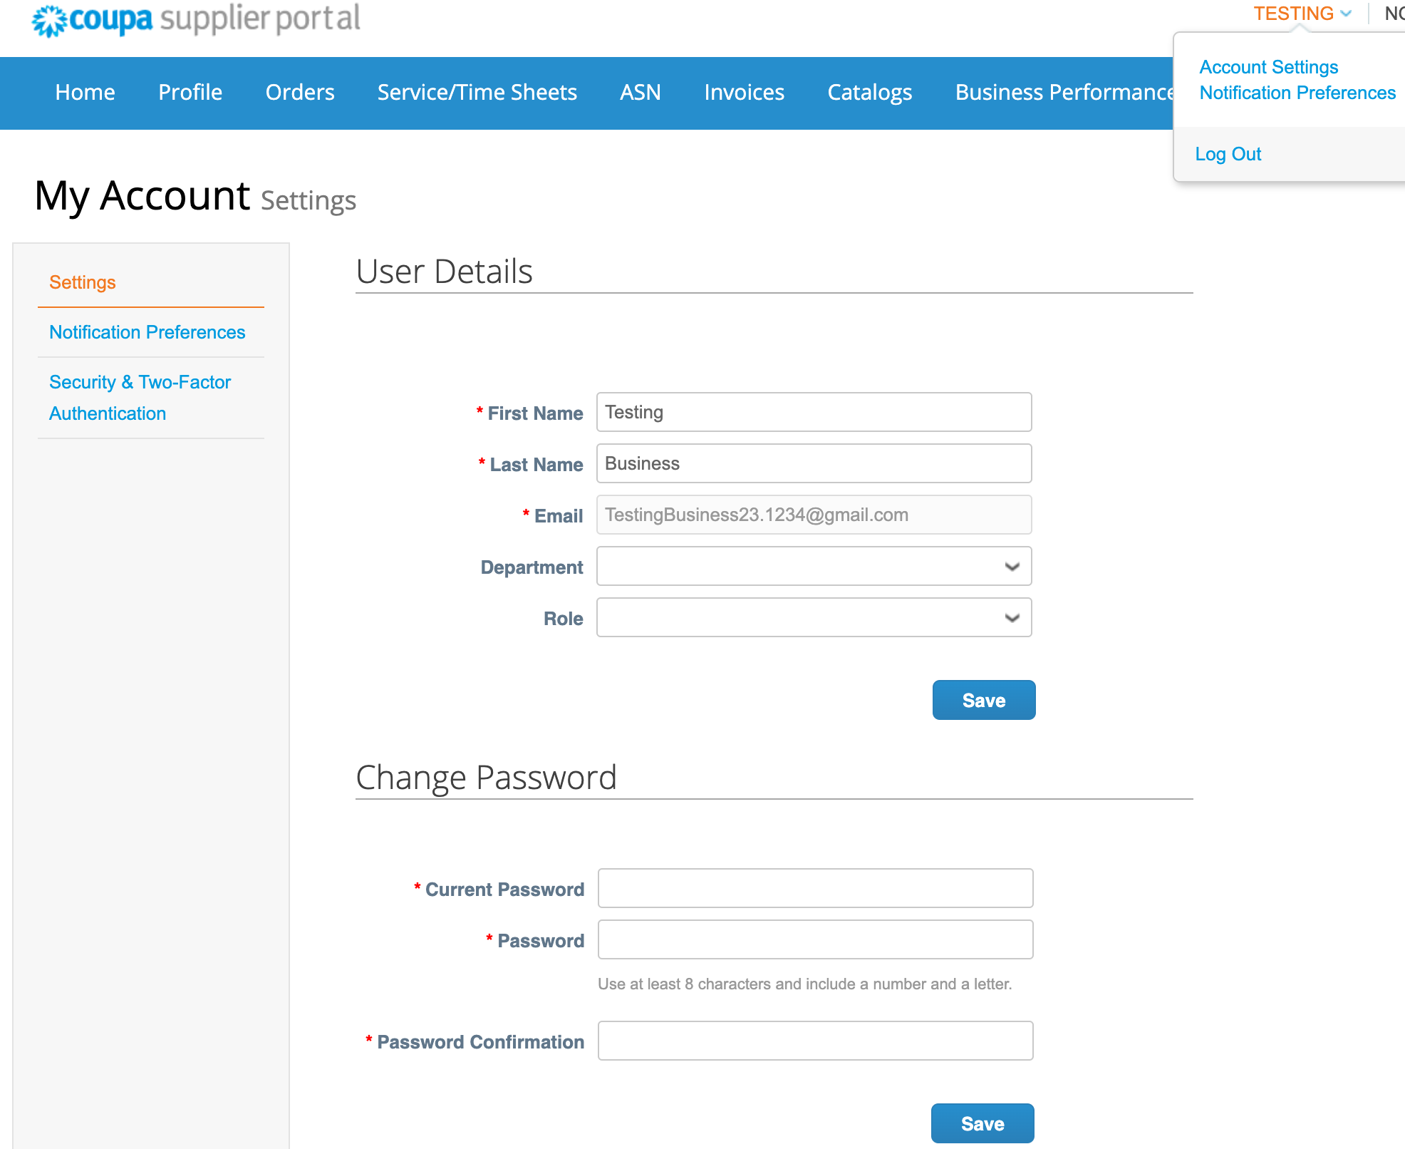
Account Administration – Account Settings
Hovering over your profile name in the top right corner will expose some Account Administration settings
On the My Account Settings page, you can make changes to your personal information
  Name
  Department
  Role
  Password

Slide 16
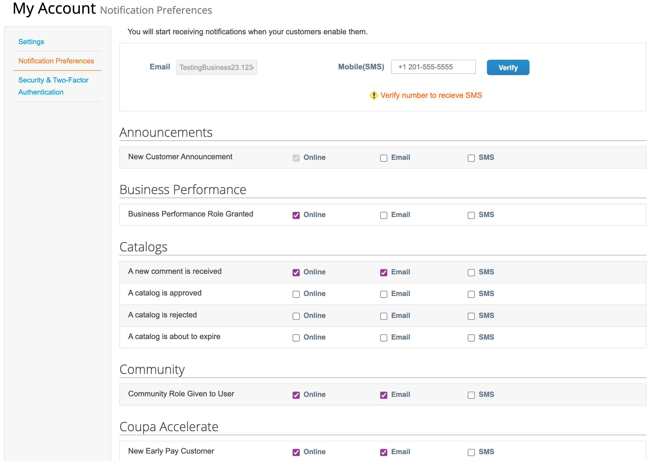
Account Administration – Notification Preferences
Selecting Notification Preferences allows you to set which notification you would like to receive and via which method

Slide 17
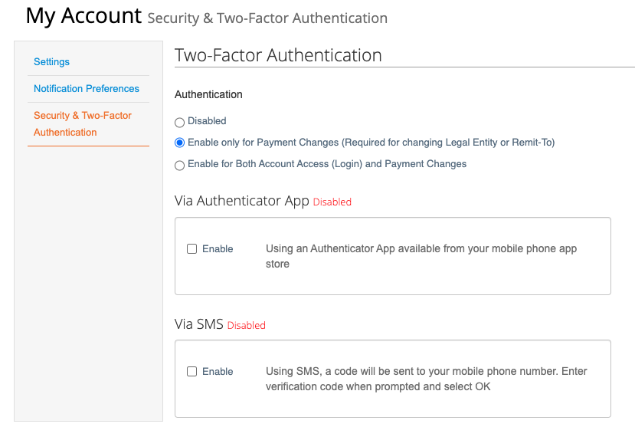
Account Administration – Security
Finally, the Security page is where you can set the Authentication Method for your CSP profile

Slide 18
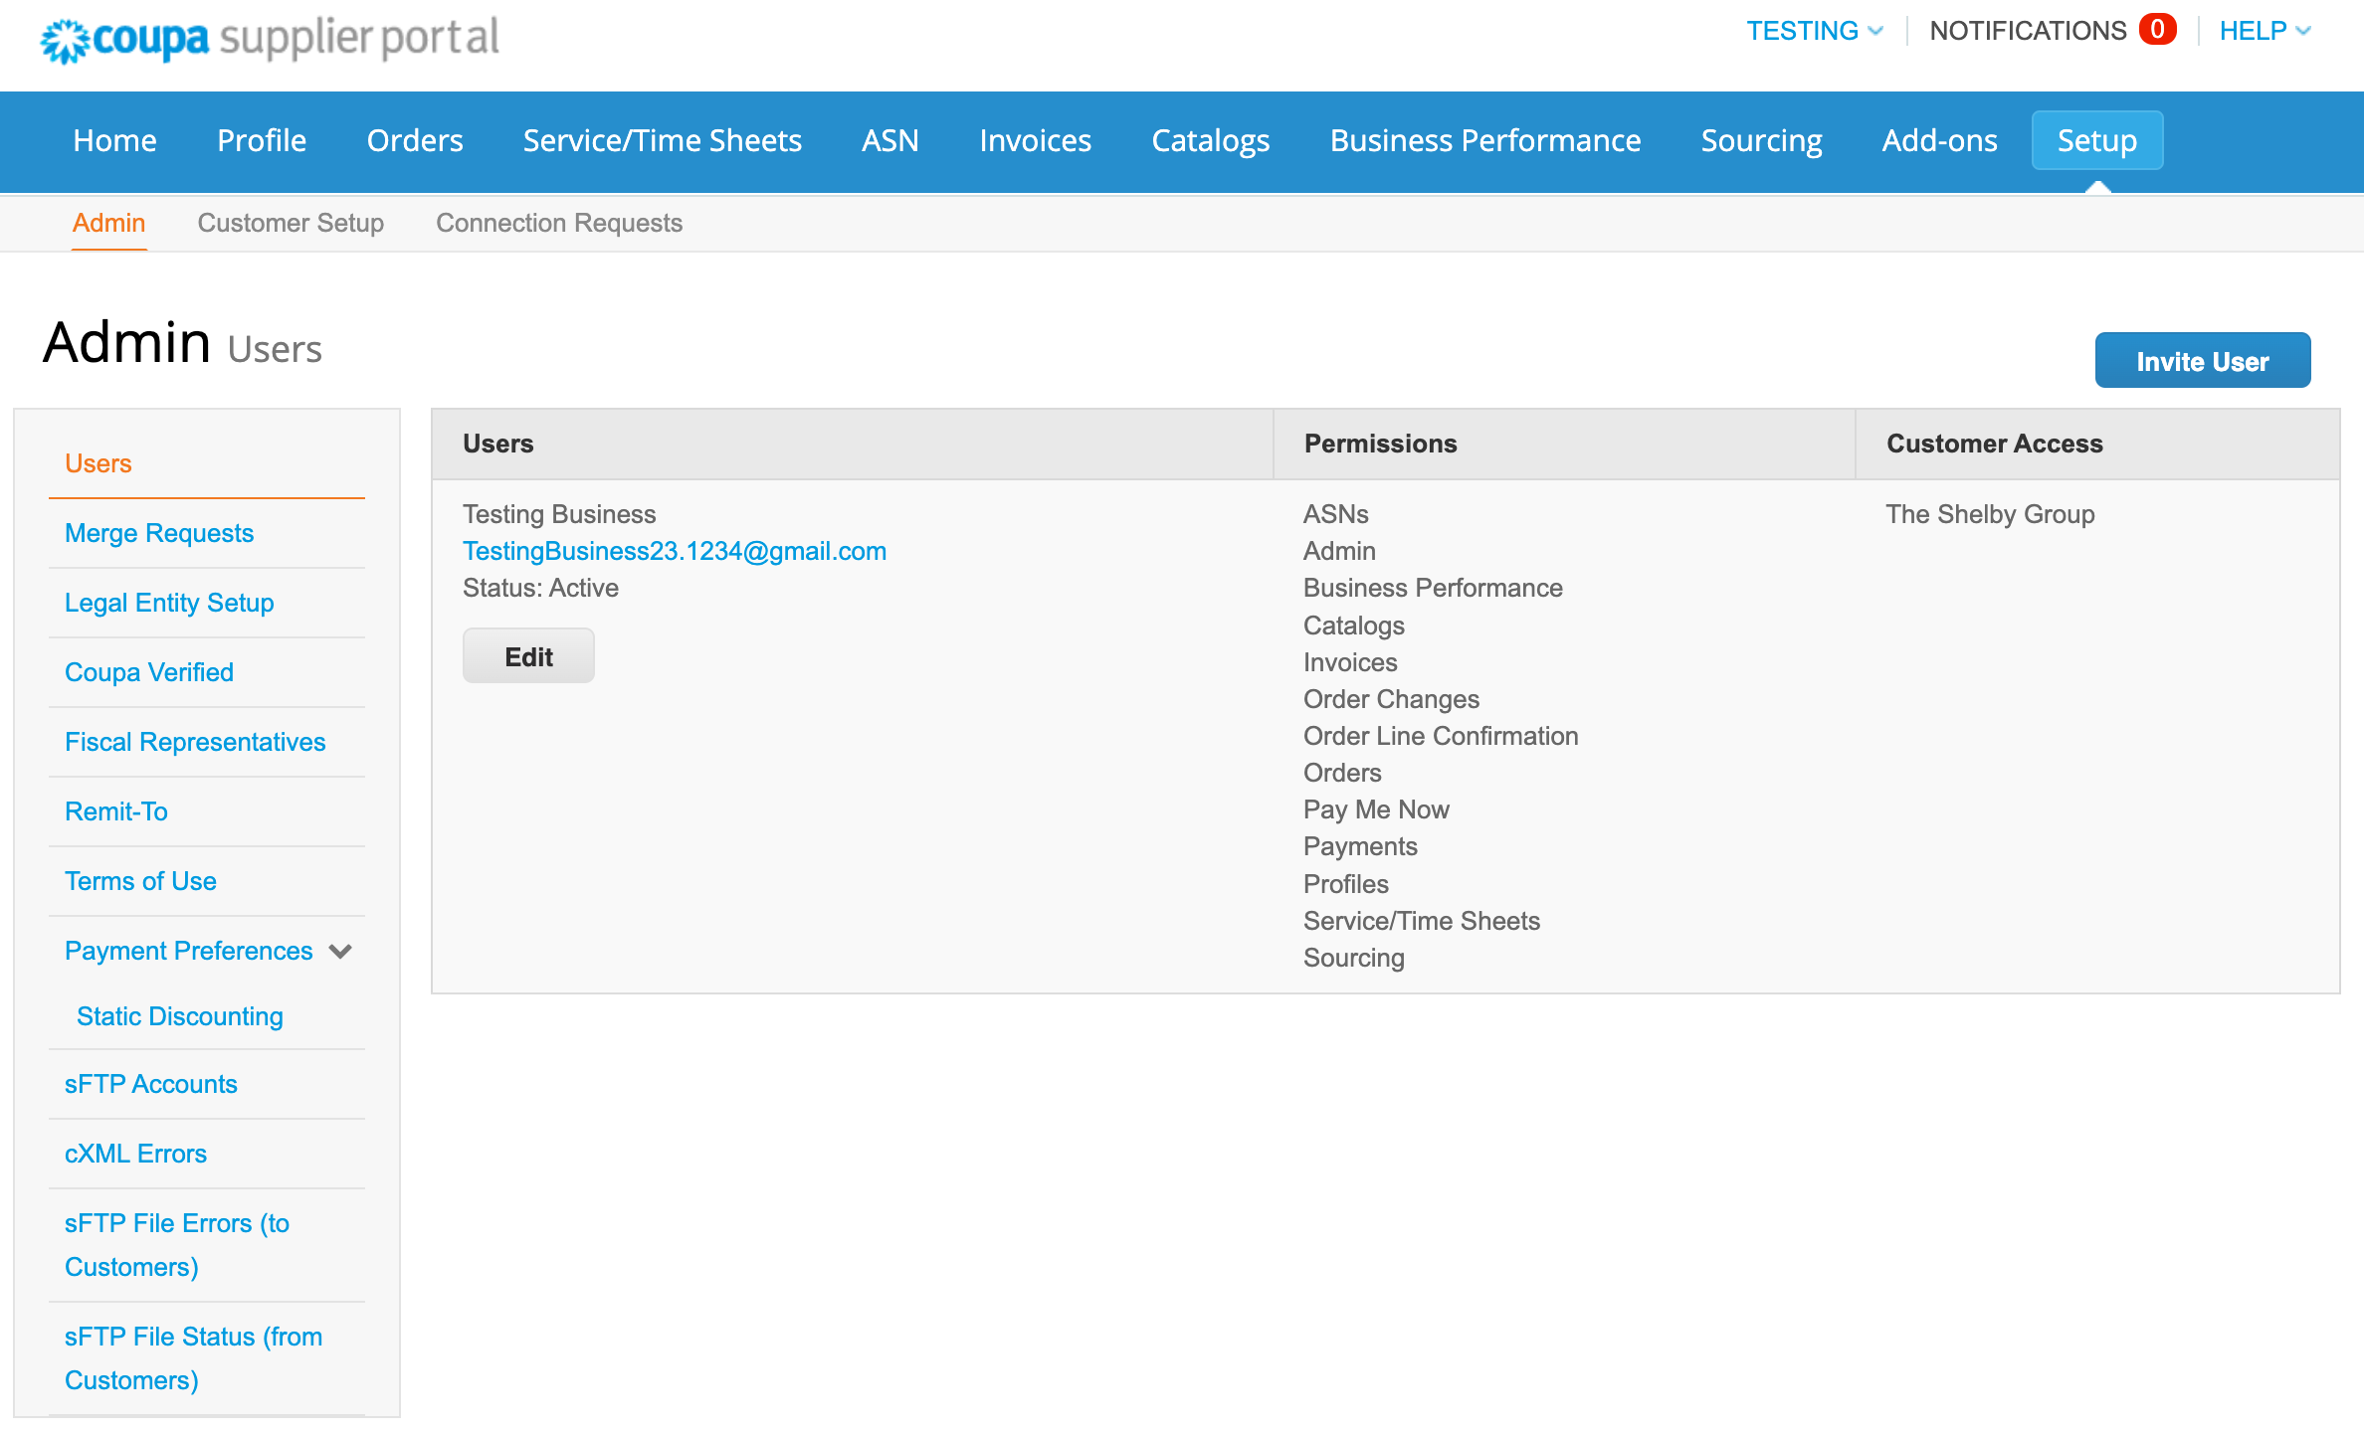
Admin Setup
Users with Admin permissions can manage profile-wide settings and data by navigating to Setup > Admin

Slide 19
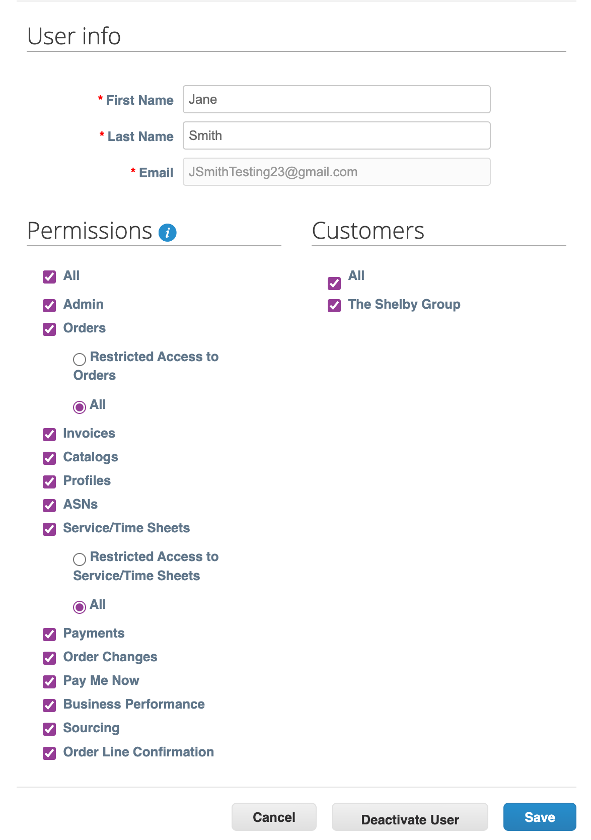
Admin Setup – Users
Admins can edit the permissions of CSP users
Selecting permissions will adjust the view on that user’s home page as it controls which tabs and functions users can access
Admins can also select which customers your users have access to

Slide 20
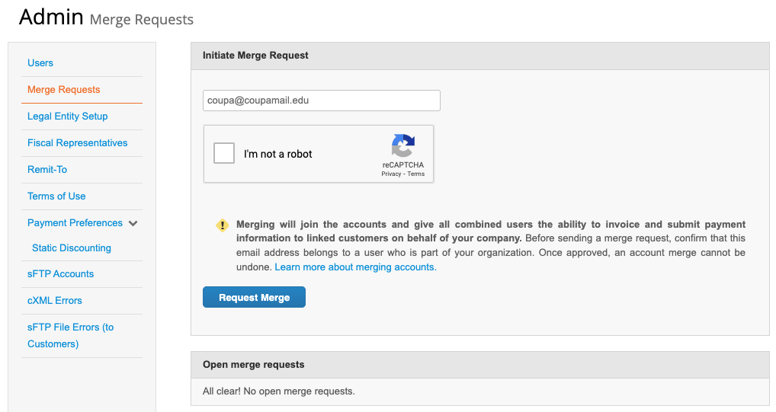
Admin Setup – Merge Requests
Your company may have more than one account/profile in the CSP. This can happen when several users from the same company register or are invited to the CSP through different email addresses
If there is ever a need to merge these accounts, Admins have the ability and responsibility to perform the required action
Visit the Coupa Compass portal for more information on Merge

Slide 21
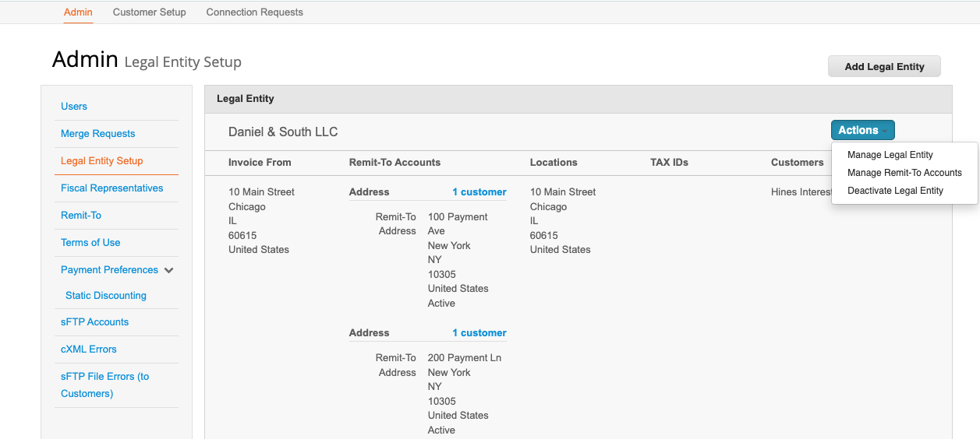
Admin Setup – Legal Entities
Admins also can Add or Manage the account’s Legal Entities
Legal Entities are comprised of
  Basic Company Info
  Tax ID
  Addresses
    Primary
    Remit To
    Ship From
    Return
Remit To addresses will be associated with Legal Entities

Slide 22
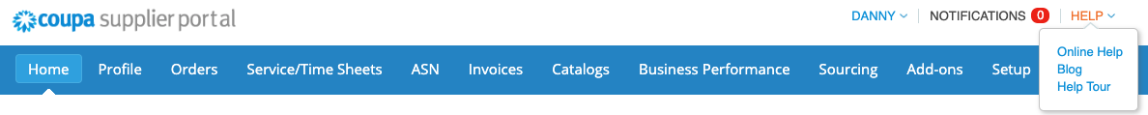
Getting Help
If you skipped the Welcome Tour, you could access it any time by clicking on Help Tour from the HELP drop down in the top right corner
For additional help, if supplier users can also click on the Online Help link which will redirect you to Coupa Support. They will be able to assist you with any technical issues
For any process concerns, please follow up with your designated Dream contact

Slide 23
CSP Transactions
Purchase Orders
Invoices
Payments

Slide 24
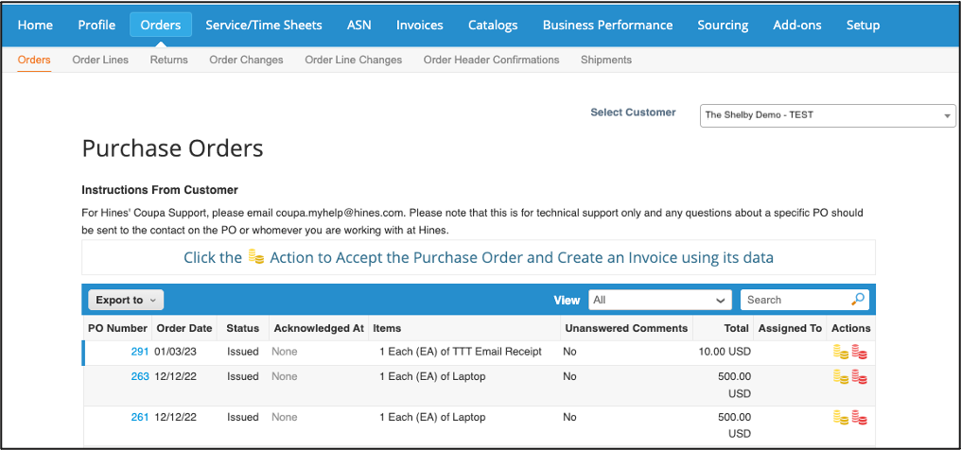
Purchase Orders
From Orders tab, CSP users can monitor and interact with POs from their various customers
The page can be filtered according to the appropriate customer using the Select Customer drop-down list in the top right corner
Icons under the Action column
  Gold coins flip PO into an invoice
  Red coins create a credit note

Slide 25
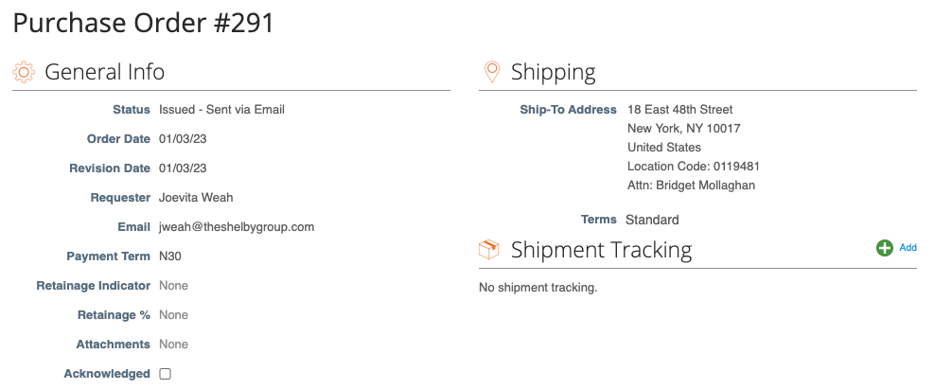
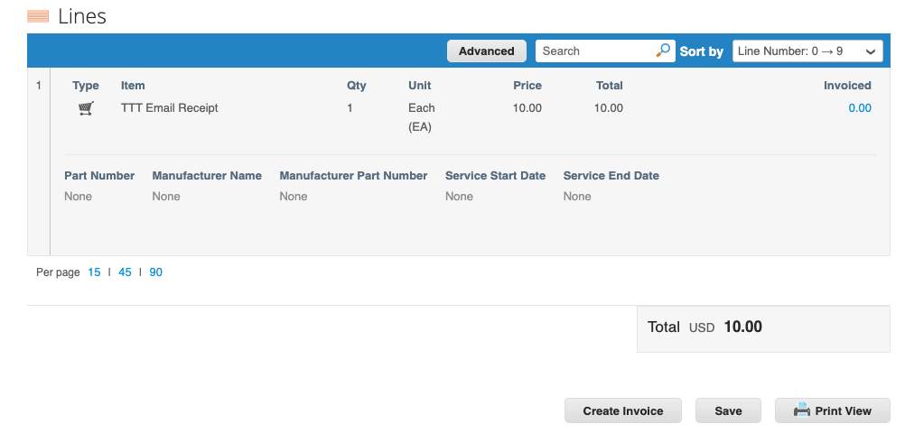
Purchase Orders
Under the PO Number column click on the number to open and view the PO and perform the following actions:
  Acknowledge PO
  Add Shipment Tracking
  Print View

Slide 26
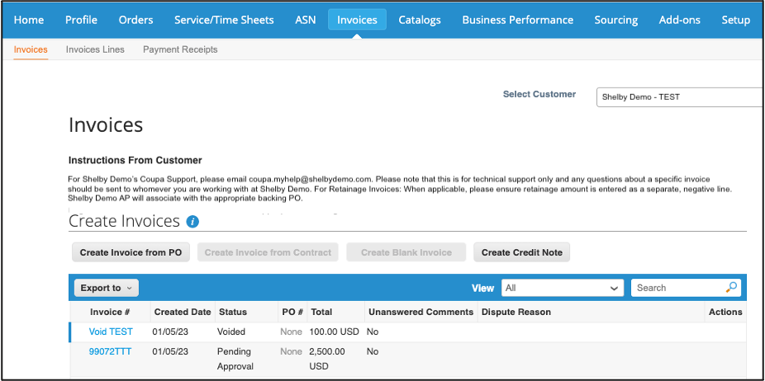
Invoices
Select the Invoices tab to monitor existing Coupa invoices or create new ones efficiently
Invoices can be created via:
  Flip PO (gold coins)
  Create Invoice from PO (create button)
Suppliers can use the View dropdown to filter table or utilize the search bar to process the appropriate documents
Accessible blue hyperlinks allow you to open an invoice or the associated PO by clicking the document #

Slide 27
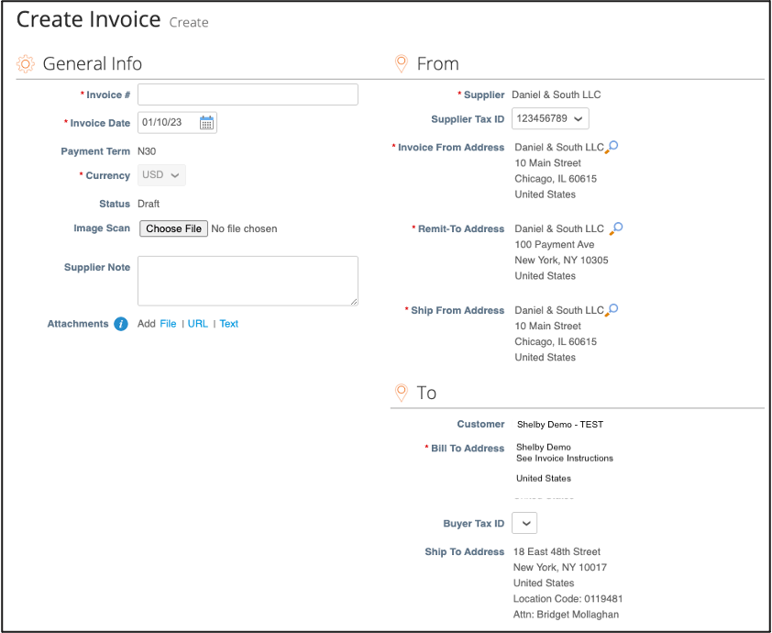
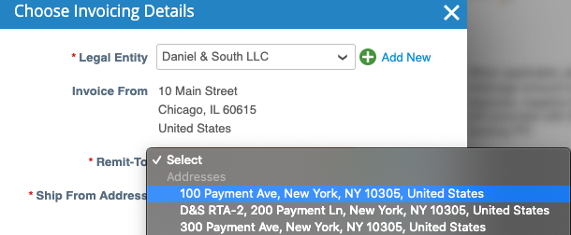
Creating Invoices – Header
Populate all the required header fields
Specify a previously created RTA for this particular transaction

Slide 28
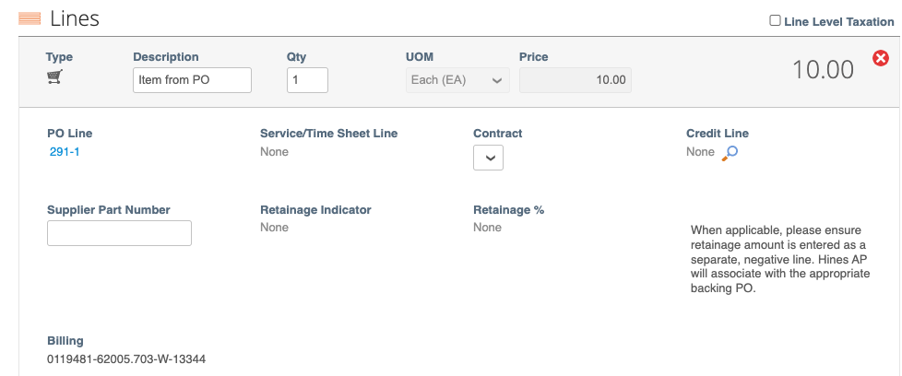
Creating Invoices – Lines
Populate all the required line fields (most will default from the PO)

Slide 29
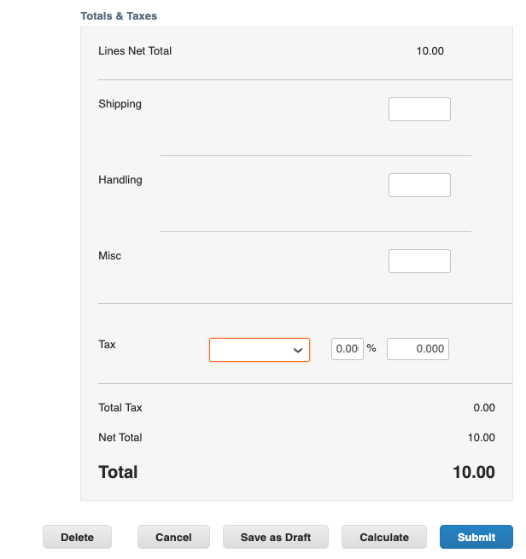
Creating Invoices – Summary
Suppliers can add Summary Level charges as applicable
Calculate the invoice total and Submit the invoice to the customer
Customers will then receive the invoice in their Coupa instance and will process for approvals and payment

Slide 30
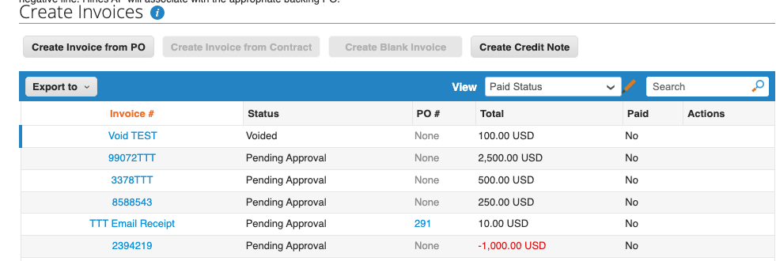
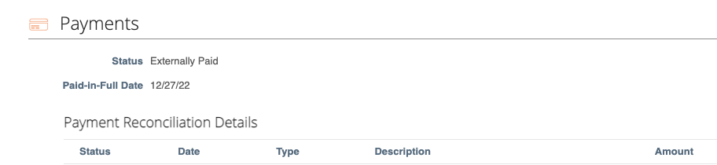
Payments
The CSP allows you to monitor the status of submitted invoices
Views can be created and leveraged to check the payment status of transactions

Slide 31
Thank you for your participation!
Note: if you need additional assistance, please contact Dream’s Coupa Support at coupa@dream.ca

